Slide 1


Handling Categorical data-one-hot encoding and label encoding
Presented by:
Jeevanthi kashyap
Palle Padmavathi

Slide 2
CONTENTS
Introduction
Challenges
Example
Techniques in Encoding
Missing values in categorical data
Sample Dataset
Code Implementation
ML Model
Conclusion
References

Slide 3
Objective
The objective is to bridge the gap between the qualitative nature of categorical information and the quantitative requirements of machine learning models, facilitating the extraction of insights and knowledge from diverse datasets in a manner that aligns with the objectives of the analysis or prediction task at hand.

Slide 4
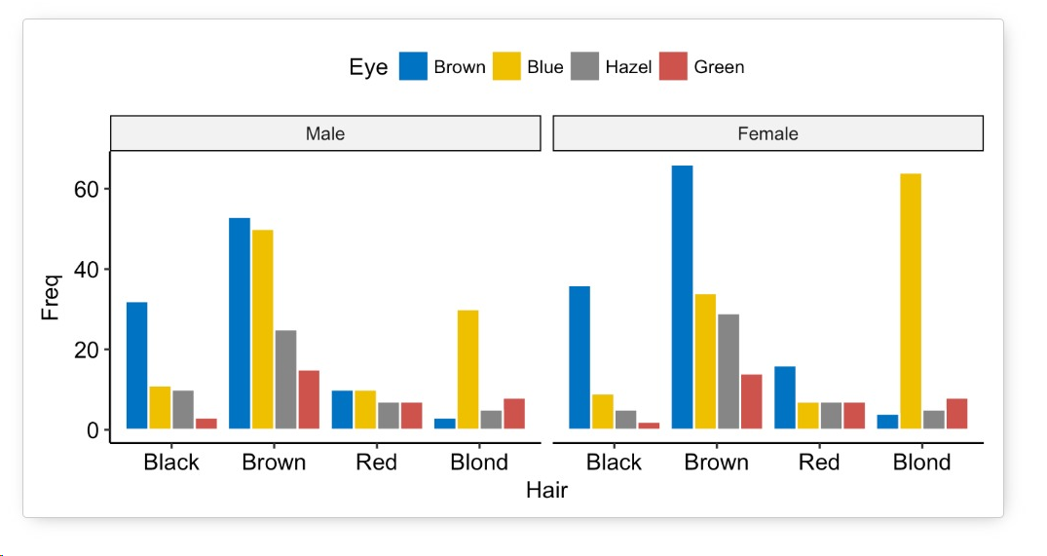
Introduction
What is Categorical data?
Categorical data is a type of data that represents categories or labels. These categories can take on values that are often represented by labels or names and do not have a natural numerical order.
There are two main types of categorical data:
Nominal Data
Ordinal Data

Slide 5
Challenges
Handling Missing Values
01
High Cardinality
03
Ordinal vs. Nominal Variables
Choosing the Right Encoding Method
02
04

Slide 6
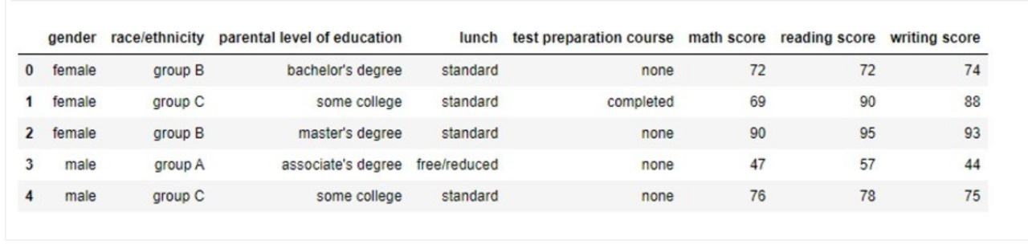
Dataset
Example

Slide 7
Why we need to handle categorical data?
Compatibility with Algorithms
Prevention of Misinterpretation
Appropriate Handling of Missing Values
Interpretability of Results
Enhancement of Model Performance

Slide 8
Techniques
Label Encoding
One-hot encoding
Ordinal Encoding
Target Encoding
Frequency(count) Encoding
Binary Encoding
Hashing Trick

Slide 9
TECHNIQUES WE USE
One-Hot Encoding:
Description:Converts categorical variables into binary vectors, creating a new binary column for each category.
Useage: Suitable for nominal data with no inherent order among categories.
Label Encoding:
Description: Assigns a unique integer to each category.
Useage: Suitable for ordinal data with a meaningful order among categories.

Slide 10
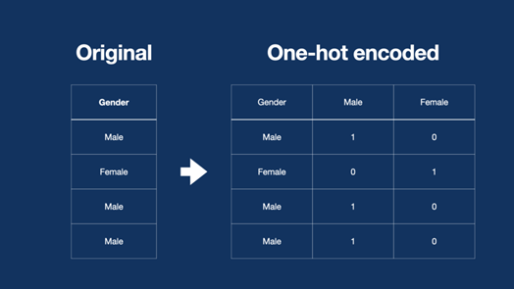
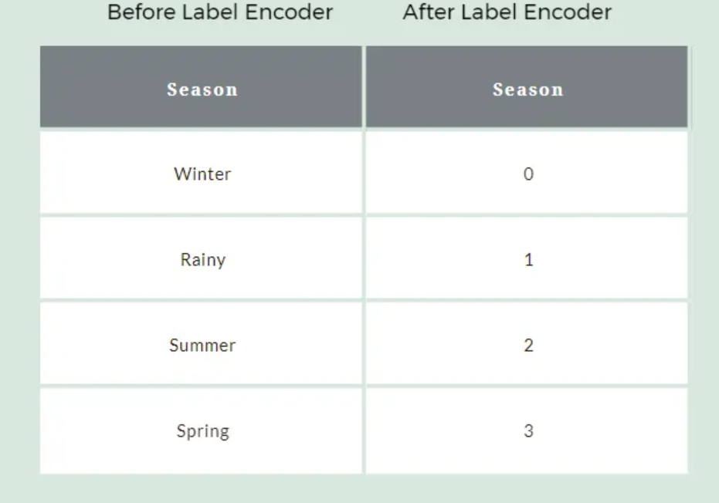
Encoding
One-hot Encoding
Label Encoding

Slide 11

Encoding

Slide 12
INTRODUCTION TO MISSING VALUES IN CATEGORICAL DATA
Real-world datasets are messy and contain missing values. Sometimes missing values are also referred to as NULL or NaN values. It is essential to handle missing values in a dataset before performing EDA. Missing values can occur for various reasons, such as data entry errors, sensor malfunctions, or intentional omission of information. .

Slide 13
HOW DOES MISSING DATA AFFECT YOUR ALGORITHMS
If missing values are not properly dealt with and imputed during the EDA (Exploratory Data Analysis) stage, a data scientist or researcher may come up with inaccurate insights or assumptions about the data.
These inaccurate insights can subsequently have a significant impact on the ML (Machine Learning) modeling phase.
Missing values can reduce the true representativeness of the dataset.
As a result, the statistical significance of the analysis performed can be reduced.
Therefore, it is crucial to properly deal with and impute missing values to ensure accurate insights and reliable ML models

Slide 14
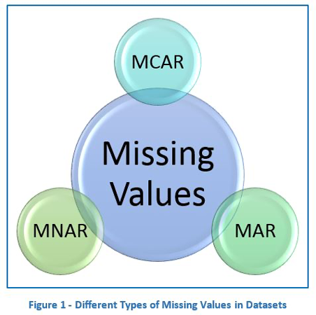
TYPES OF MISSING VALUES
Missing values can be categorized into three categories :
Missing Completely at Random (MCAR)
Missing at Random (MAR)
Missing Not at Random (MNAR)

Slide 15
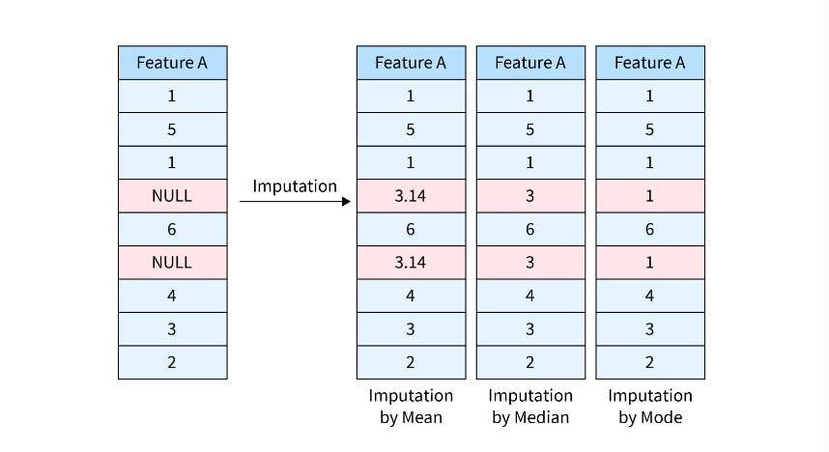
COMMONLY USED IMPUTATION METHODS

Slide 16
HOW TO HANDLE MISSING DATA?
There are many ways to handle missing values in a dataset
Removing Missing Values
Frequent Categorical Imputation
Adding a Variable To Capture NAN
Create a New Category (Random Category) for NAN Values
Adding an Indicator for Missing Values

Slide 17
IMPLEMENTATION METHODS
Frequent Categorical Imputation
Assumptions: Data is Missing At Random (MAR) and missing values look like the majority.
Replacing NAN values with the most frequent occurred category in variable/column.
Implementation:
Step 1: Find which category occurred most in each category using mode().
Step 2: Replace all NAN values in that column with that category.
Step 3: Drop original columns and keep newly imputed columns.

Slide 18
IMPLEMENTATION METHODS
2. Adding a Variable To Capture NAN
Assumptions: No assumption, can be worked with all type categorical columns.
Replace NAN categories with most occurred values, and add a new feature to introduce some weight/importance to non-imputed and imputed observations.
Implementation:
Step 1.
Create a new column and replace 1 if the category is NAN else 0. This column is an importance column to the imputed category.
Step 2.
Replace NAN value with most occurred category in the actual column.

Slide 19
IMPLEMENTATION METHODS
3. Create a New Category (Random Category) for NAN Values
Assumptions: No assumption
Create a new category for NAN values i.e random category.
Implementation:
Step 1.
Replace NAN value with a new name (here we create a new category as Unknown).
Step 2.
Display result

Slide 20
ADVANTAGES/DISADVANTAGES
Frequent Categorical Imputation
Advantage: Simple and easy to implement for categorical variables/columns.
Disadvantage:
Features having a max number of null values may bias prediction if replace with the most occurred category.
It distorts the relation of the most frequent label.

Slide 21
ADVANTAGES/DISADVANTAGES
2. Adding a Variable To Capture NAN
Advantage: Capture the importance of missingness.
Disadvantage:
Creating Additional Features(Curse of Dimensionality) e.g. if there are 10 columns have null values need to create 10 extra columns.
Potentially misunderstood data & the number of missing data should be large enough.

Slide 22
ADVANTAGES/DISADVANTAGES
3. Create a New Category (Random Category) for NAN Values
Advantage: Simple and easy to implement for categorical variables/columns and preserves the variance.
Disadvantage:
May create random data if the missing category is more.
Doesn’t give good results when missing data is a high percentage of the data.

Slide 23
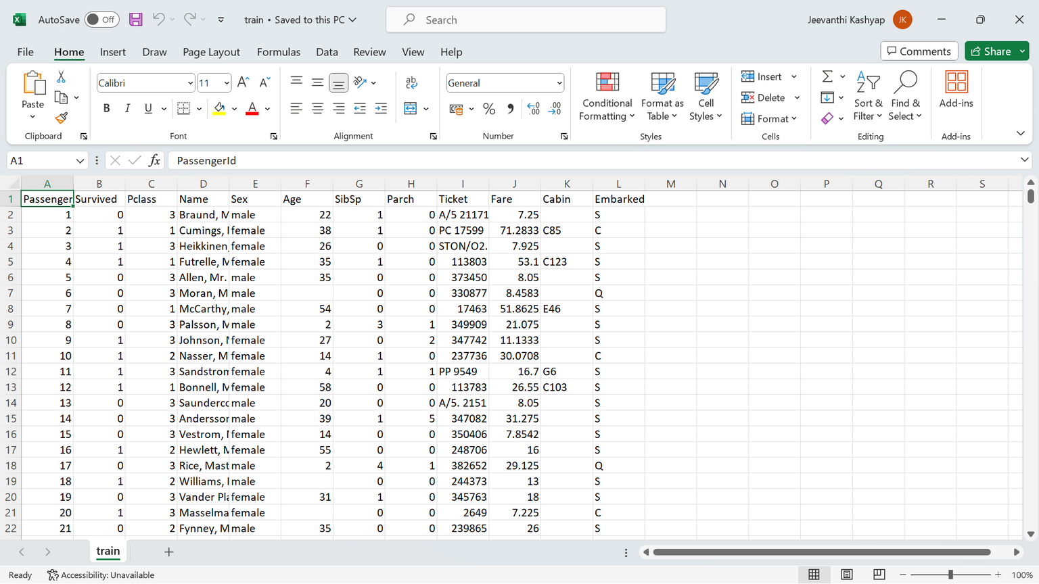
CHOOSEN DATASET: TITANIC

Slide 24
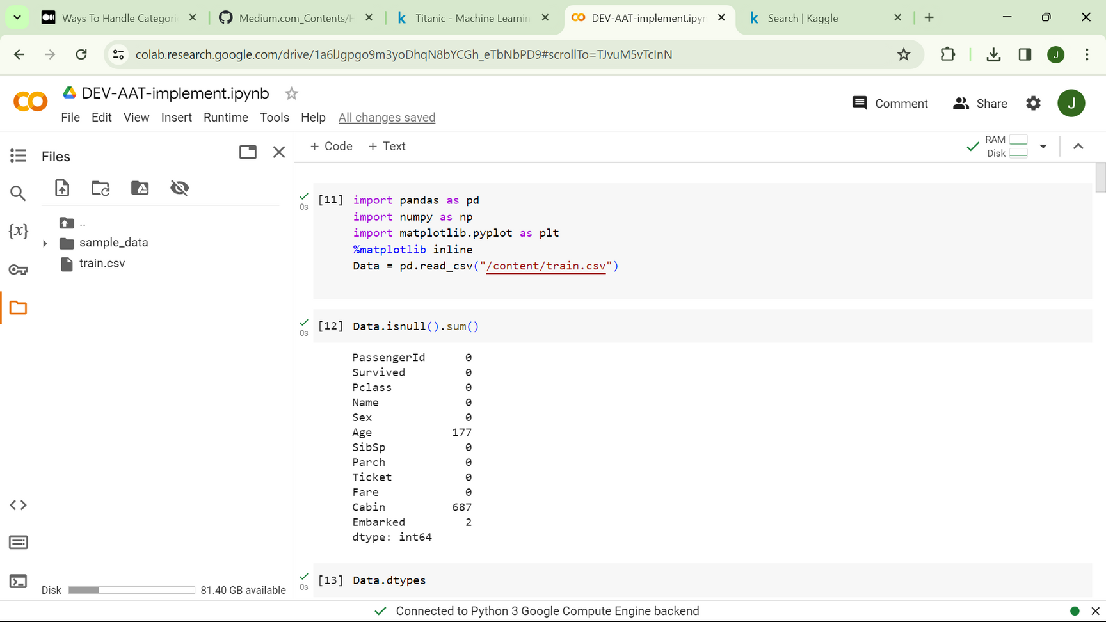
PYTHON CODE IMPLEMENTATION

Slide 25
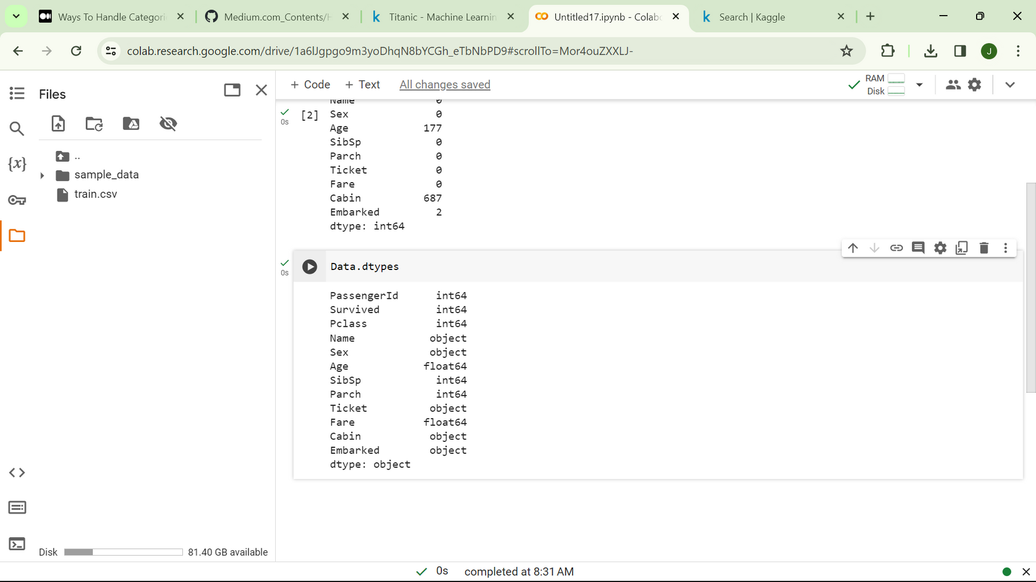
CODE IMPLEMENTATION

Slide 26
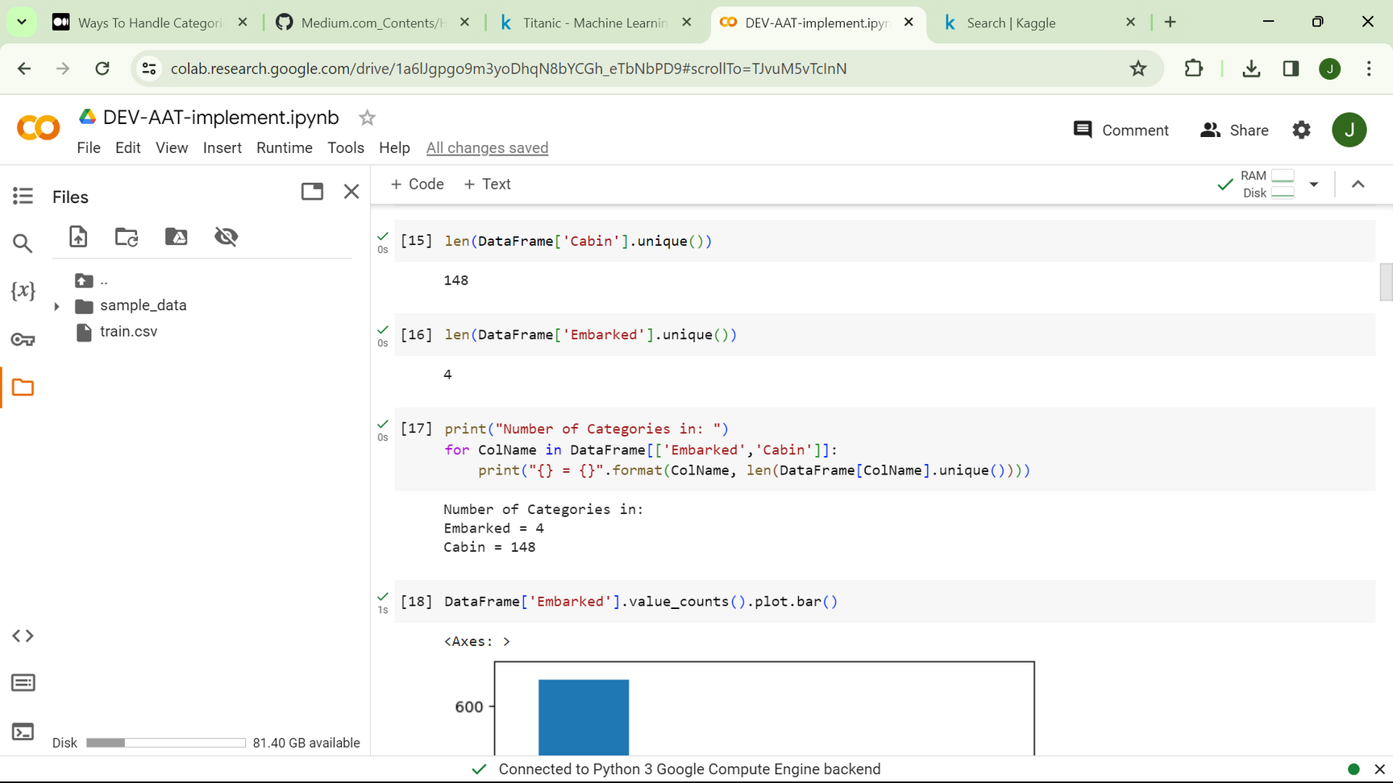
CODE IMPLEMENTATION

Slide 27
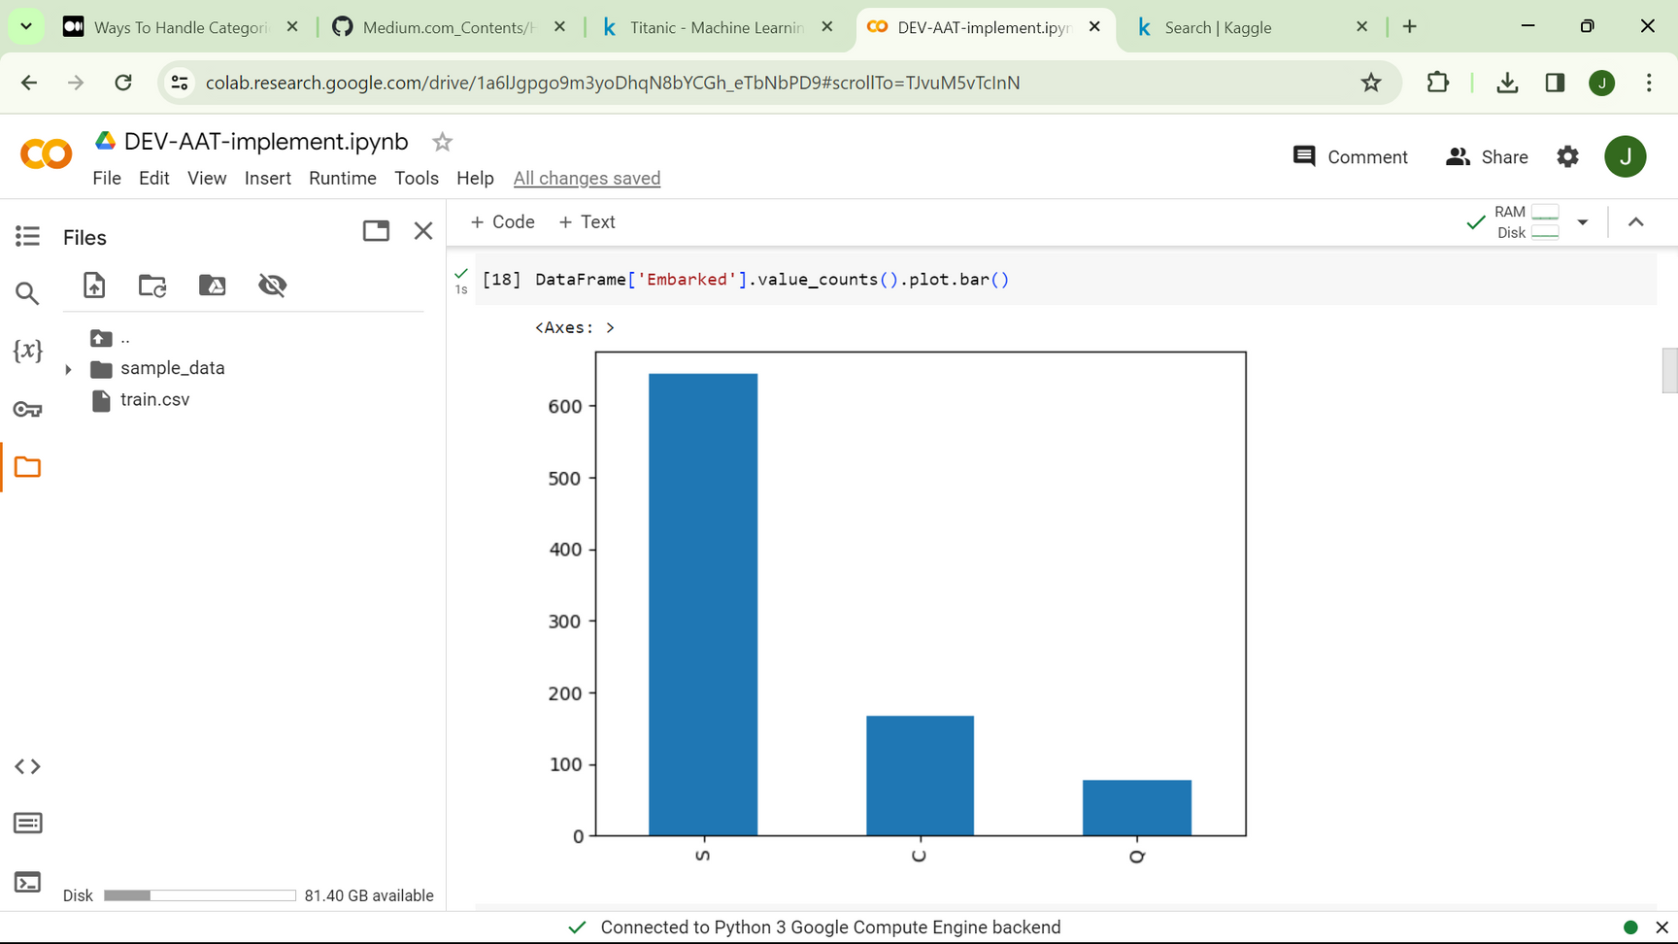
CODE IMPLEMENTATION

Slide 28
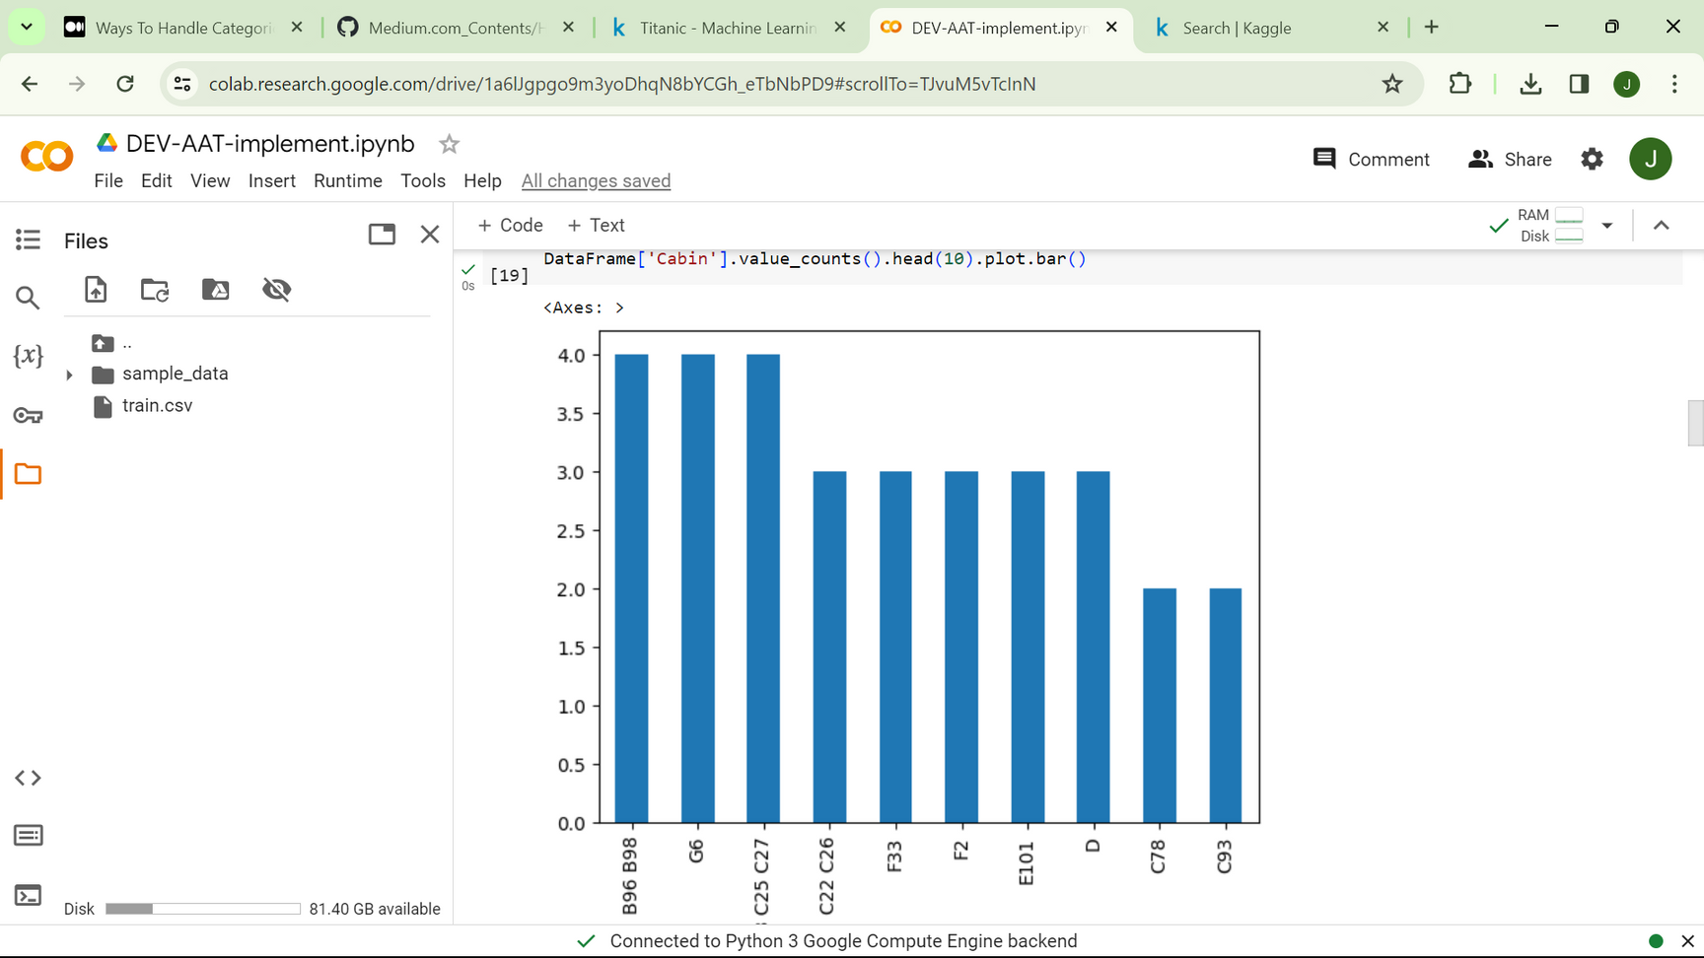
CODE IMPLEMENTATION

Slide 29
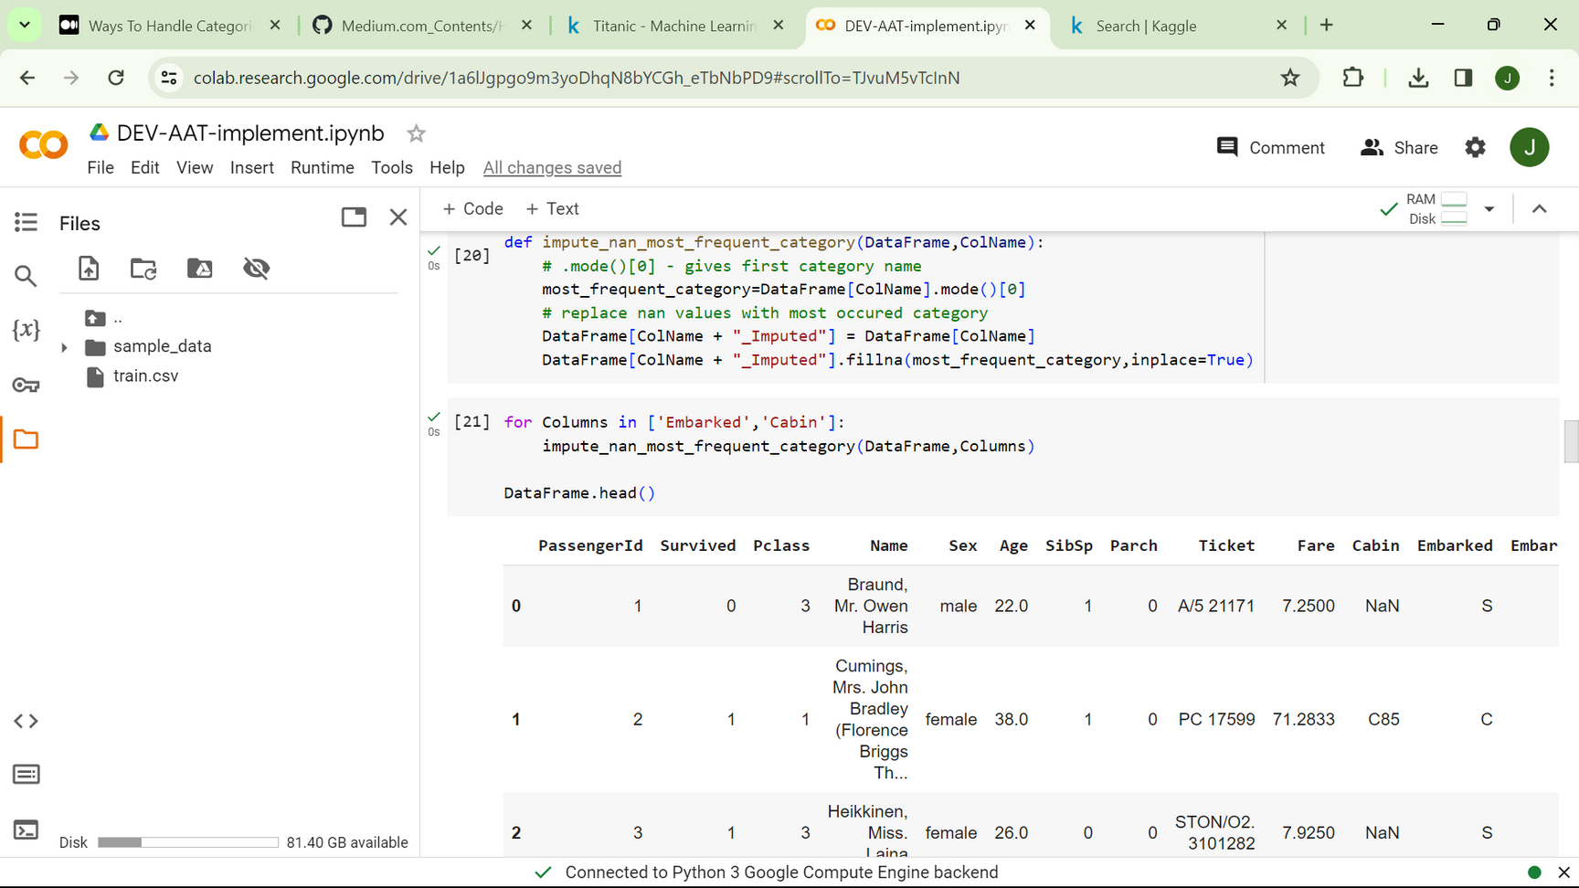
CODE IMPLEMENTATION

Slide 30
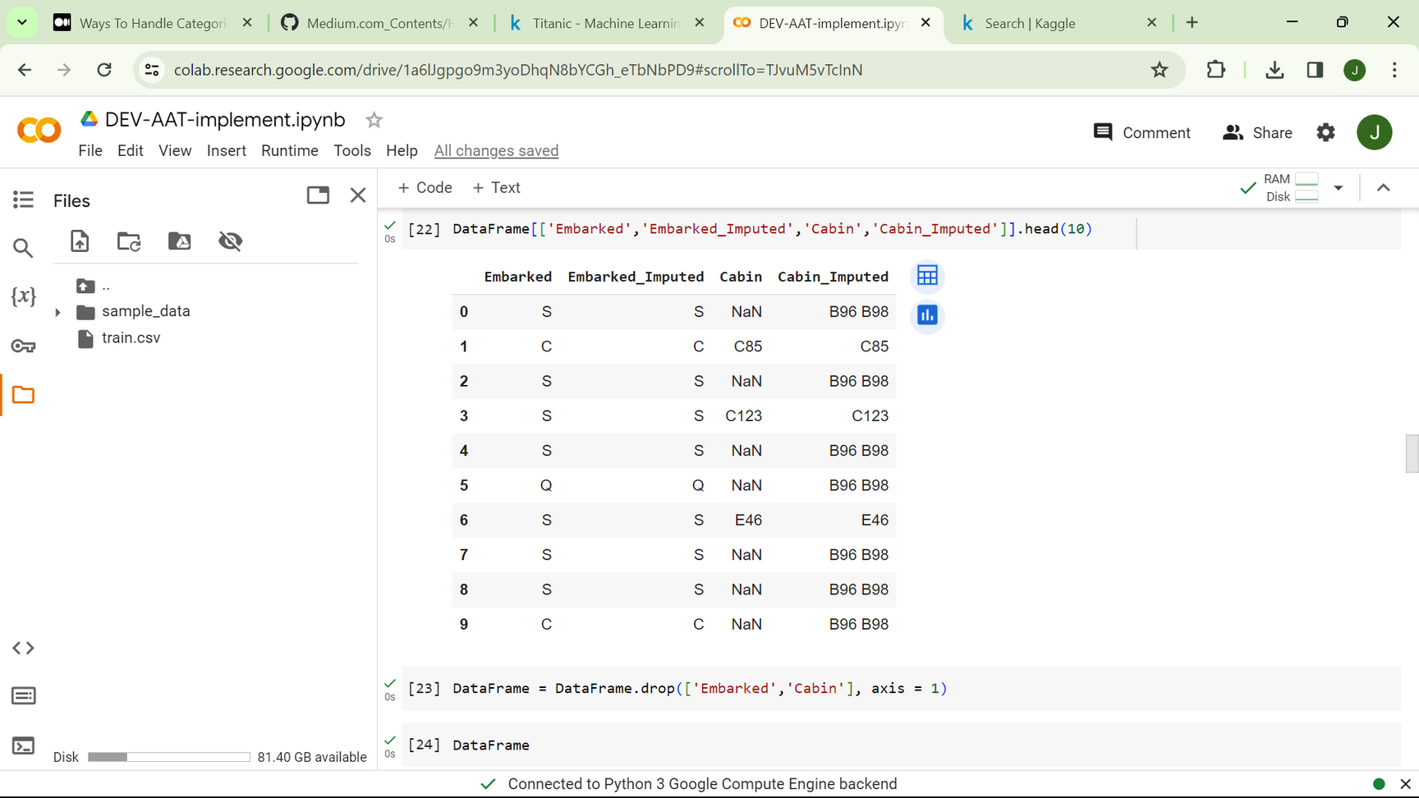
CODE IMPLEMENTATION

Slide 31
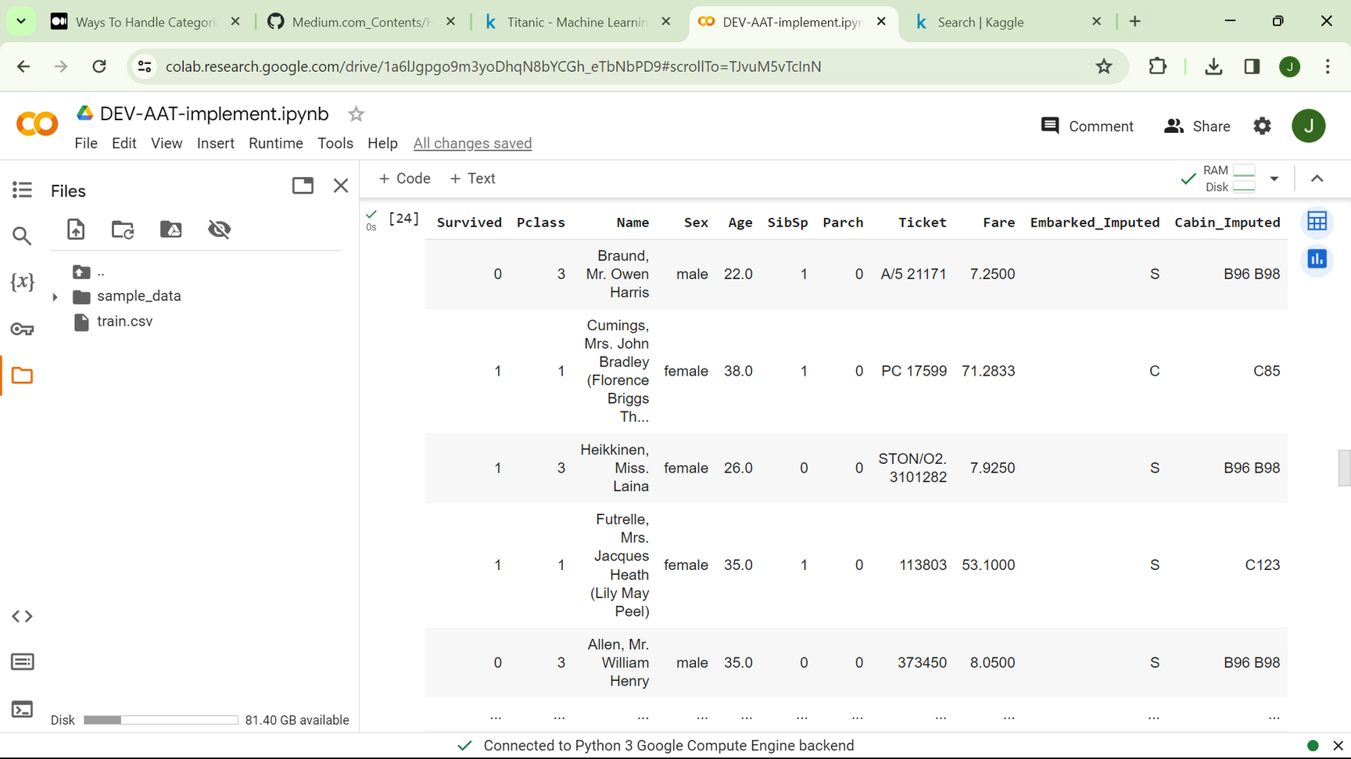
CODE IMPLEMENTATION

Slide 32
TRAINING A ML MODEL
Model training, in the context of a categorical dataset, involves feeding the dataset into a machine learning algorithm to allow it to learn the underlying patterns and relationships between the input features (categorical variables) and the target variable (usually a categorical outcome).

Slide 33
STEPS FOR IMPLEMENTING
Data Preprocessing:
Handle missing values.
Encode categorical variables.
Train-Test Split
Model Selection
Model Training
Model Evaluation

Slide 34
COMPARISONS
This differences in accuracy/performance measures of the two models trained could be due to several factors:
Imputation Bias
Information Loss
Model Sensitivity
Dataset Characteristics
Randomness

Slide 35
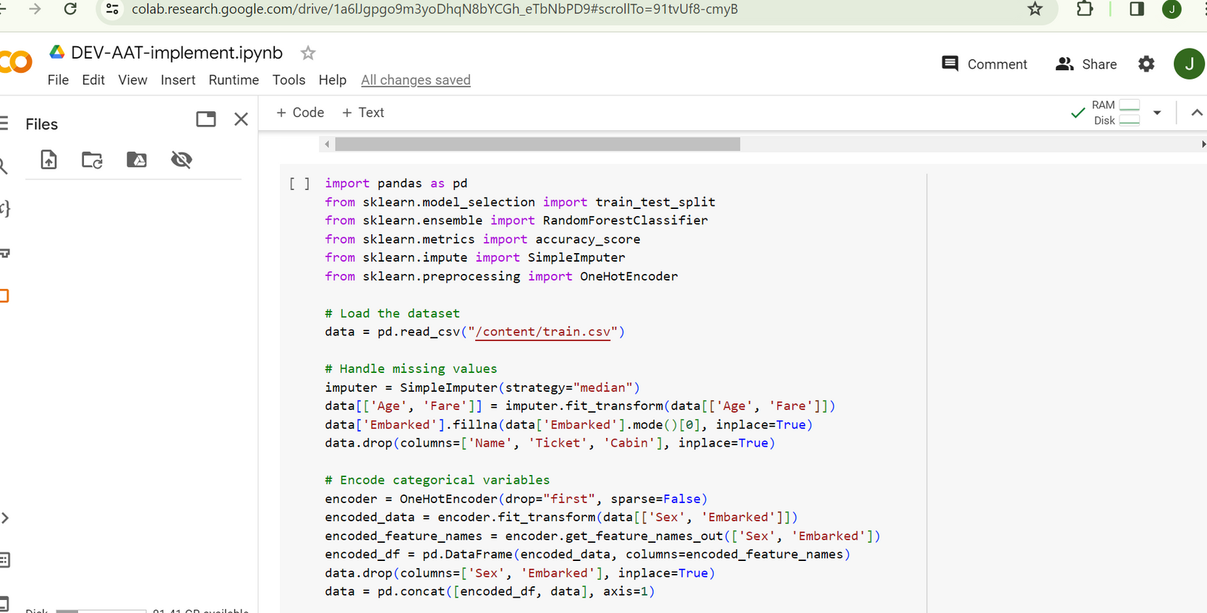
IMPLEMENTATION OF IMPUTED MODEL

Slide 36
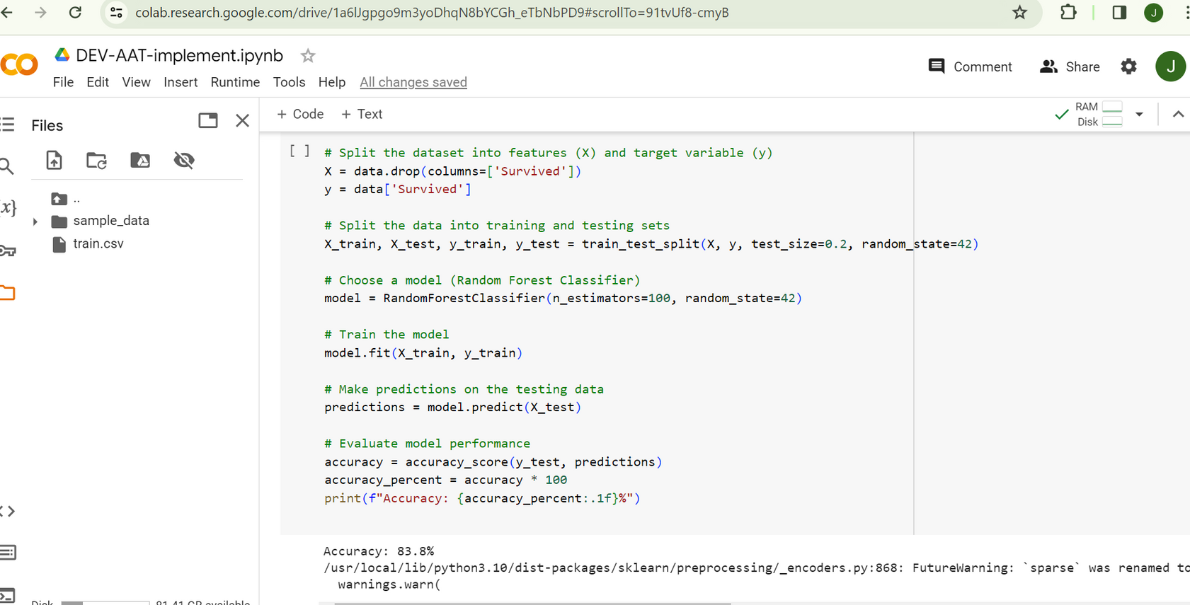
ACCURACY OUTPUT OF IMPUTED MODEL

Slide 37
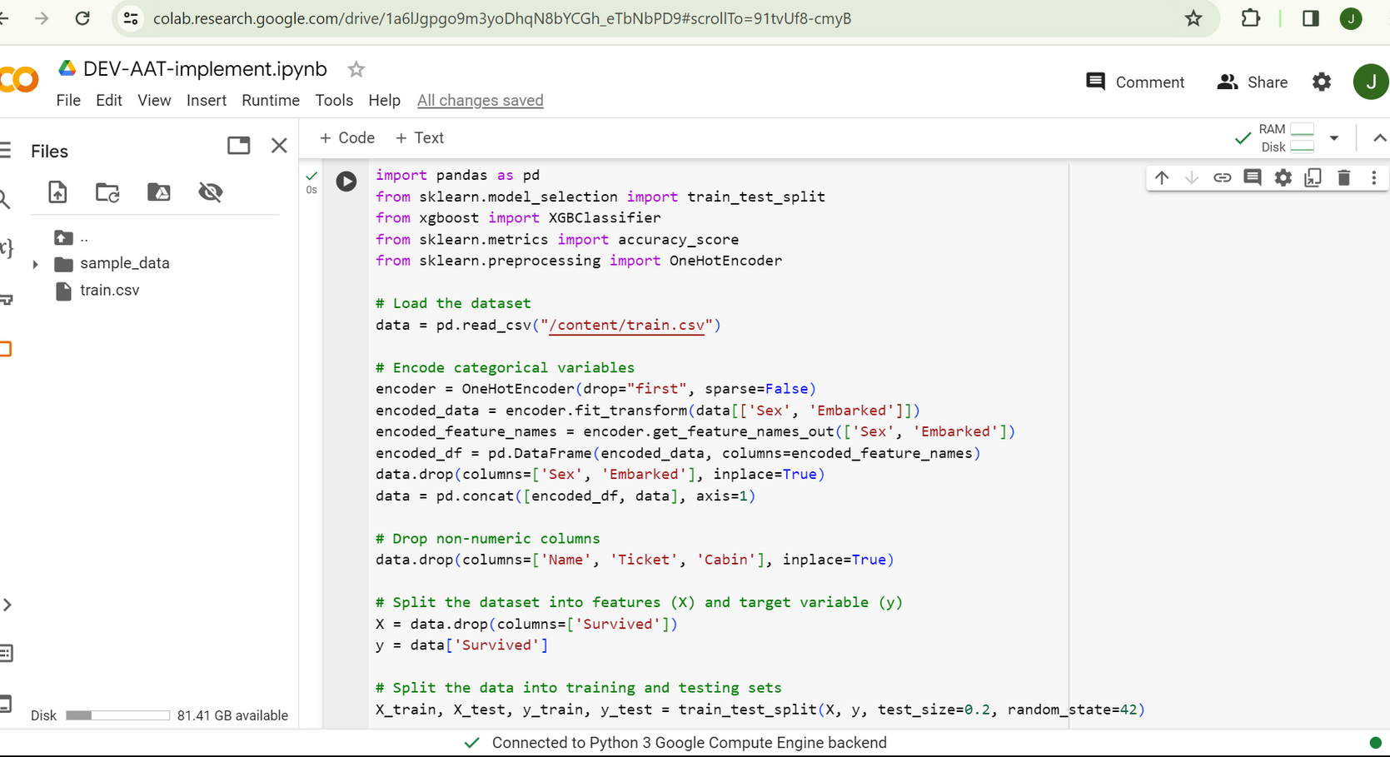
IMPLEMENTATION OF NON IMPUTED MODEL

Slide 38
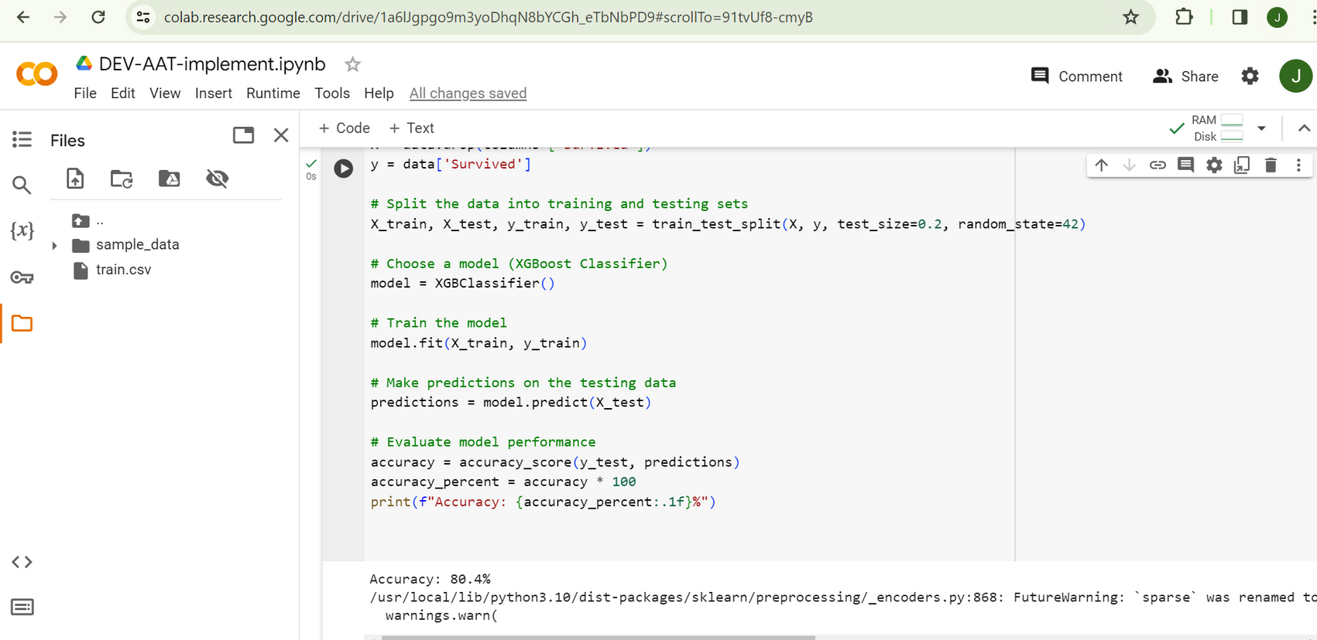
ACCURACY OUTPUT OF NON IMPUTED MODEL

Slide 39
CONCLUSION
Handling missing data is a critical step in the data preprocessing , as missing values can significantly impact the accuracy and reliability of analyses or machine learning models. The choice of a suitable strategy depends on various factors, such as the nature of the data, the reasons for missing values, and the overall goals of the analysis.
The implementations used is to explain different ways we can handle missing categorical data. The most widely used methods are Create a New Category (Random Category) for NAN Values and Most frequent category imputation.

Slide 40
REFERENCES
Kaggle Dataset Link:https://www.kaggle.com/c/titanic/data
tutorialspoint.com/how-to-handle-missing-values-of-categorical-variables-in-python

Slide 41
Thank You

